Slide 1
Predicting Prices of Airbnb Listings
Presented by Qilei Cai and Tasnim Nehal

Slide 2
Dataset
Obtained from Kaggle.com
Contains 48895 Airbnb listings located in New York City
Features include:
Neighborhood group (Manhattan, Brooklyn, etc.)
Latitude & longitude of accommodation
Minimum number of nights required for a booking
Total number of reviews received by the host
Price
Goal: train models to predict the price of an Airbnb listing

Slide 3
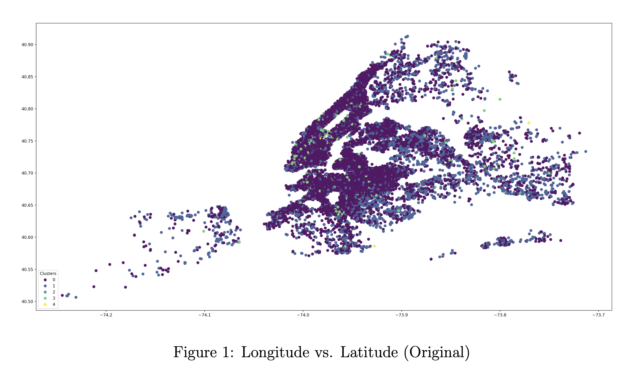
Unsupervised Analysis
Graph of longitude vs. latitude

Slide 4
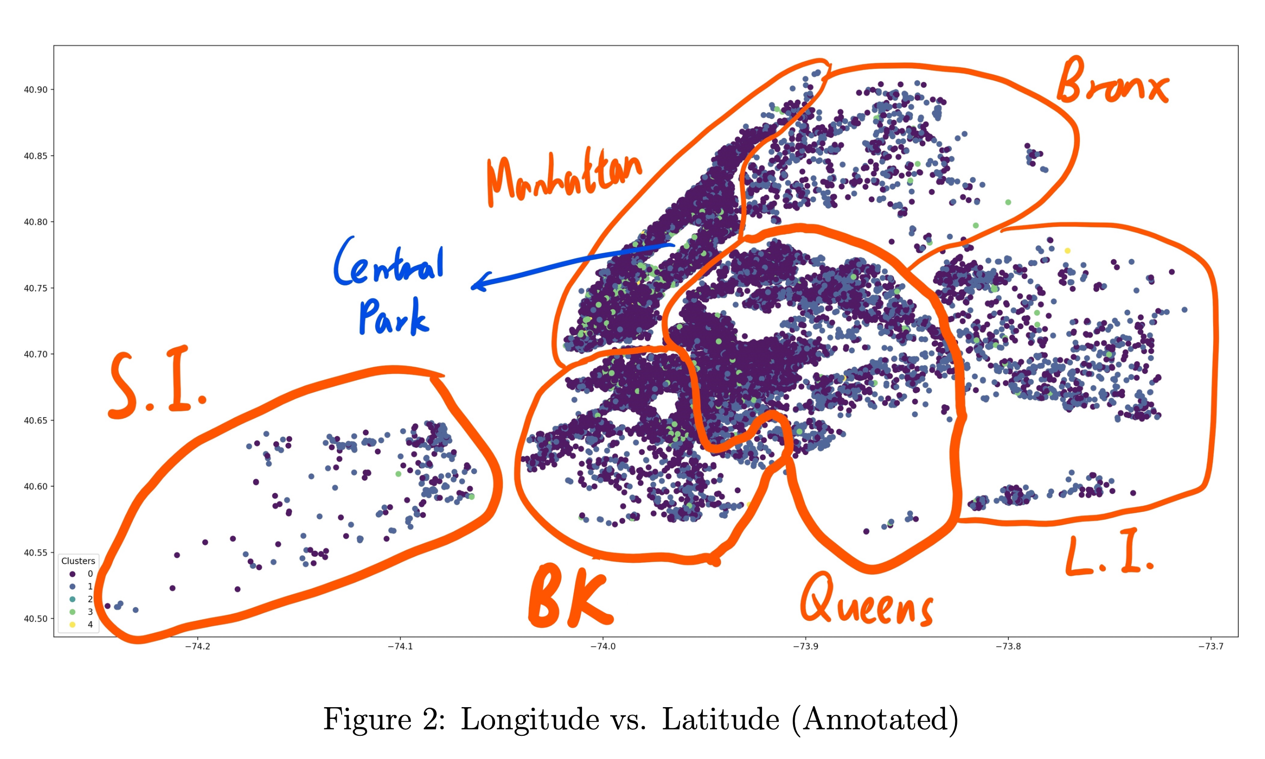
Unsupervised Analysis
Graph of longitude vs. latitude

Slide 5
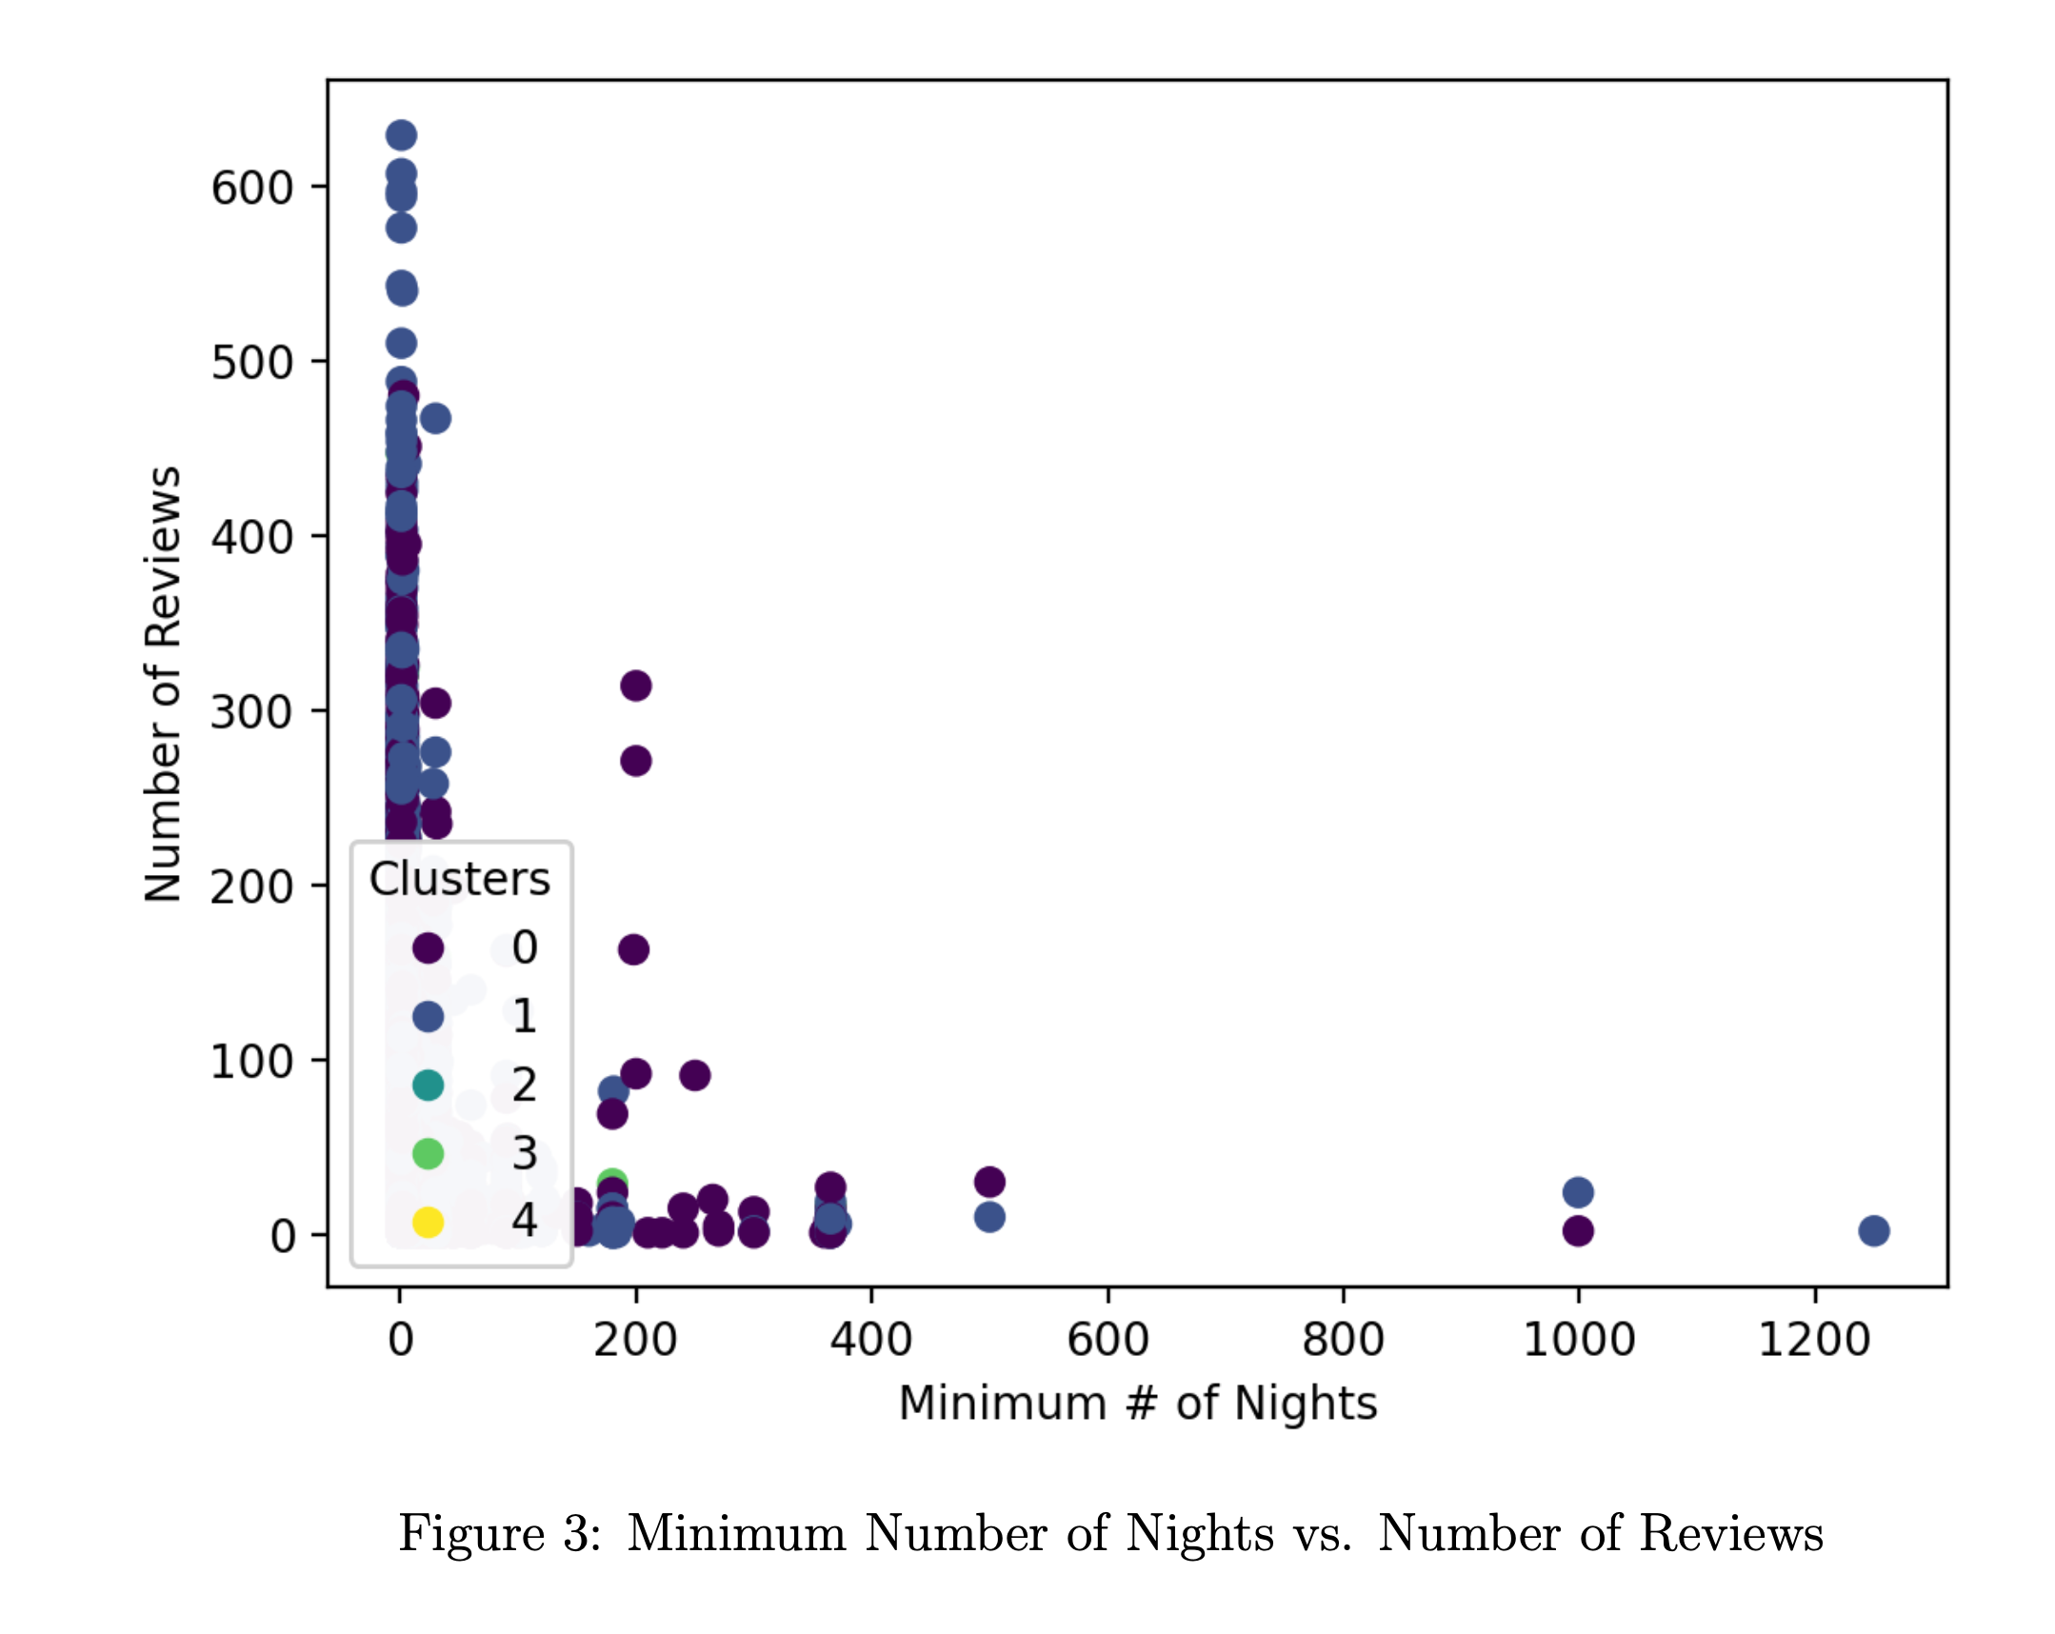
Unsupervised Analysis
Graph of minimum number of nights vs. number of reviews

Slide 6
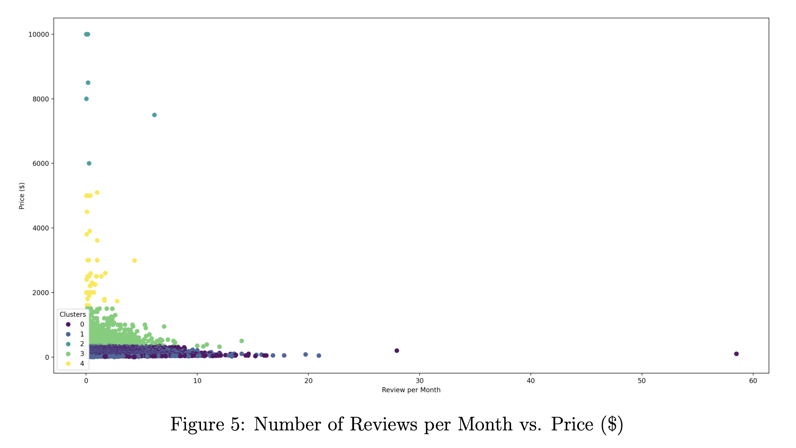
Unsupervised Analysis
Graph of number of reviews per month vs. price

Slide 7
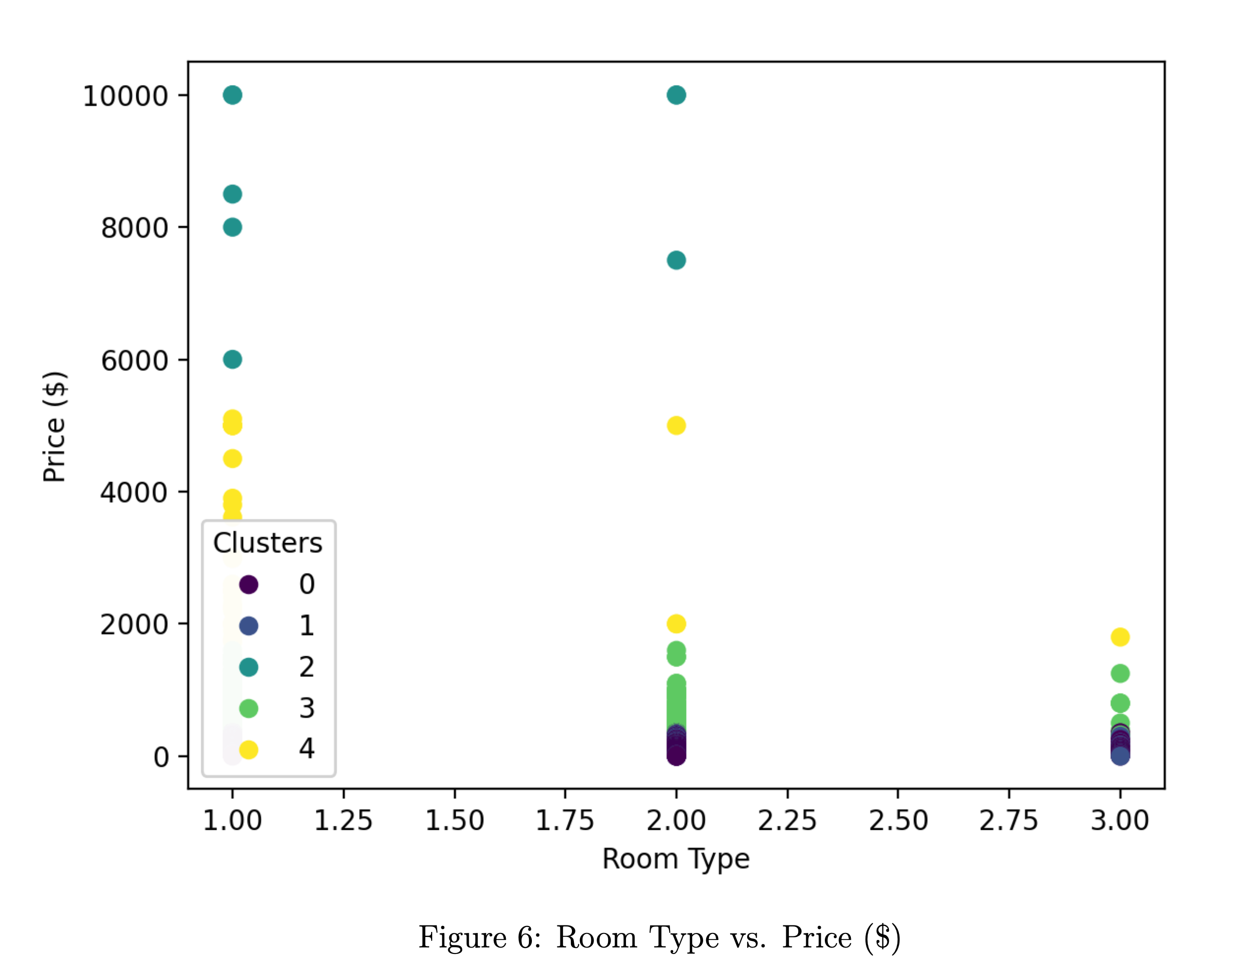
Unsupervised Analysis
Graph of room type vs. price

Slide 8
Supervised Analysis
Eight price ranges were specified
Prices were converted to integers from 0 to 7 in accordance
Label 0: $0-$199.99
Label 1: $200-$499.99
Label 2: $500-$999.99
Label 3: $1000-$1499.99
Label 4: $1500-$1999.99
Label 5: $2000-$2999.99
Label 6: $3000-$3999.99
Label 7: $4000 and above

Slide 9
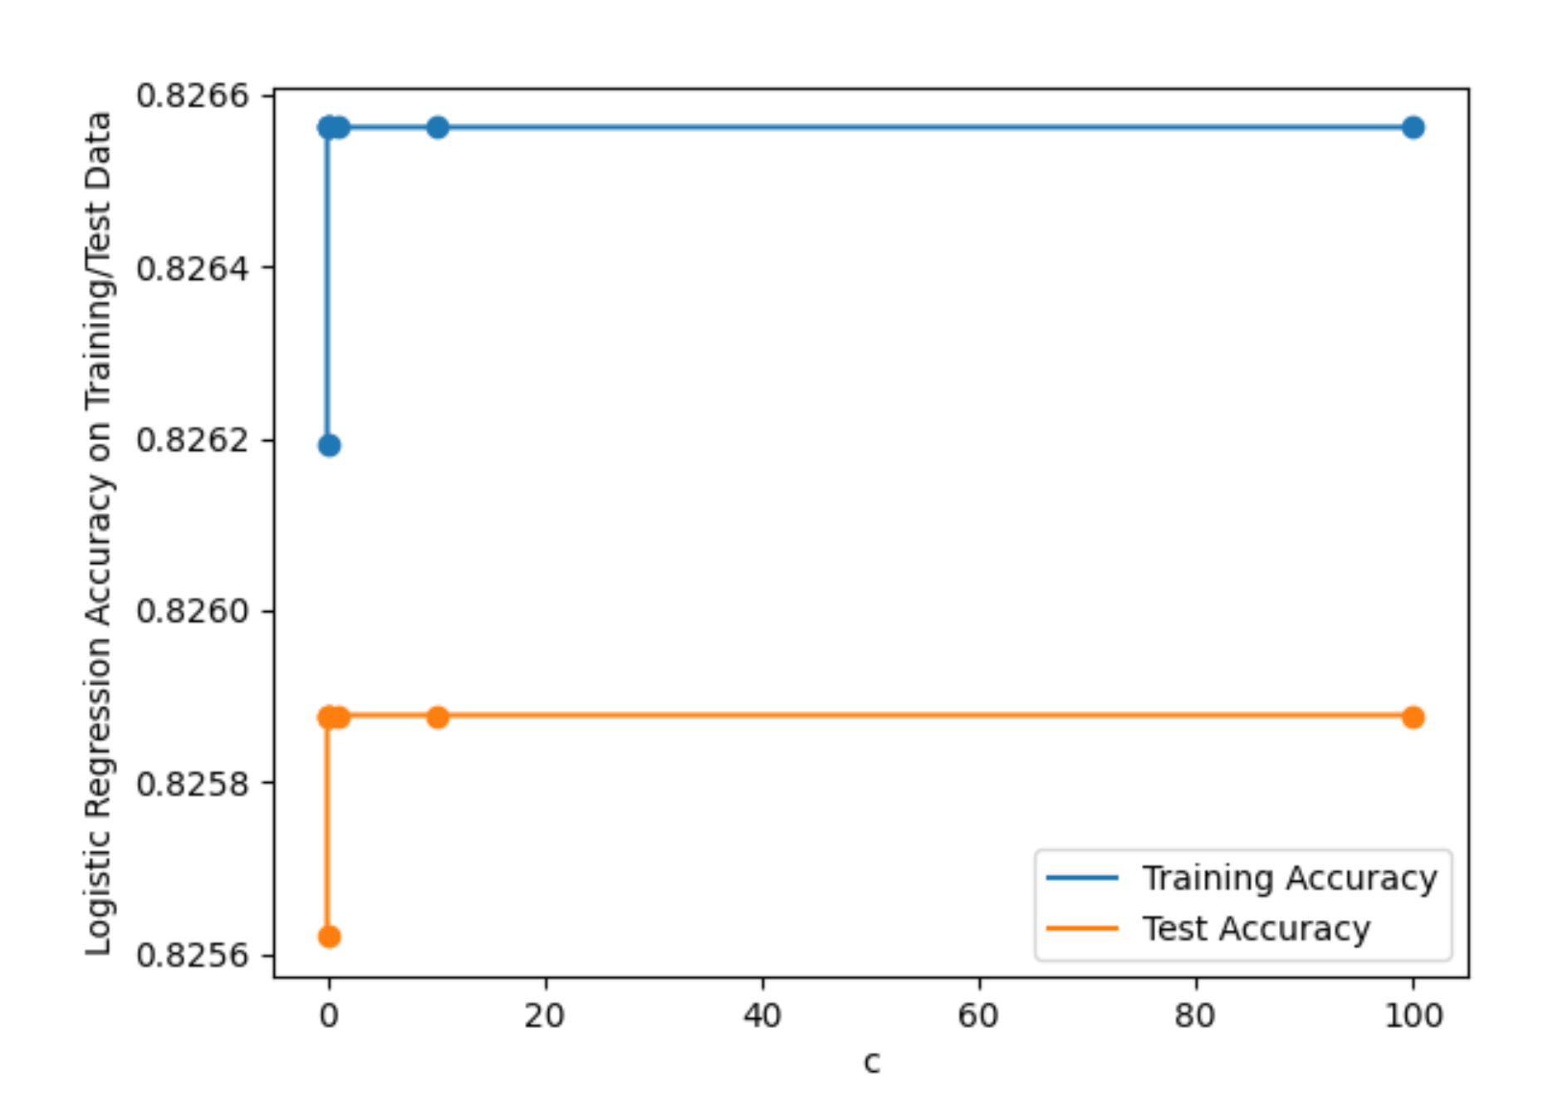
Supervised Analysis
Logistic regression with L1 regularization

Slide 10
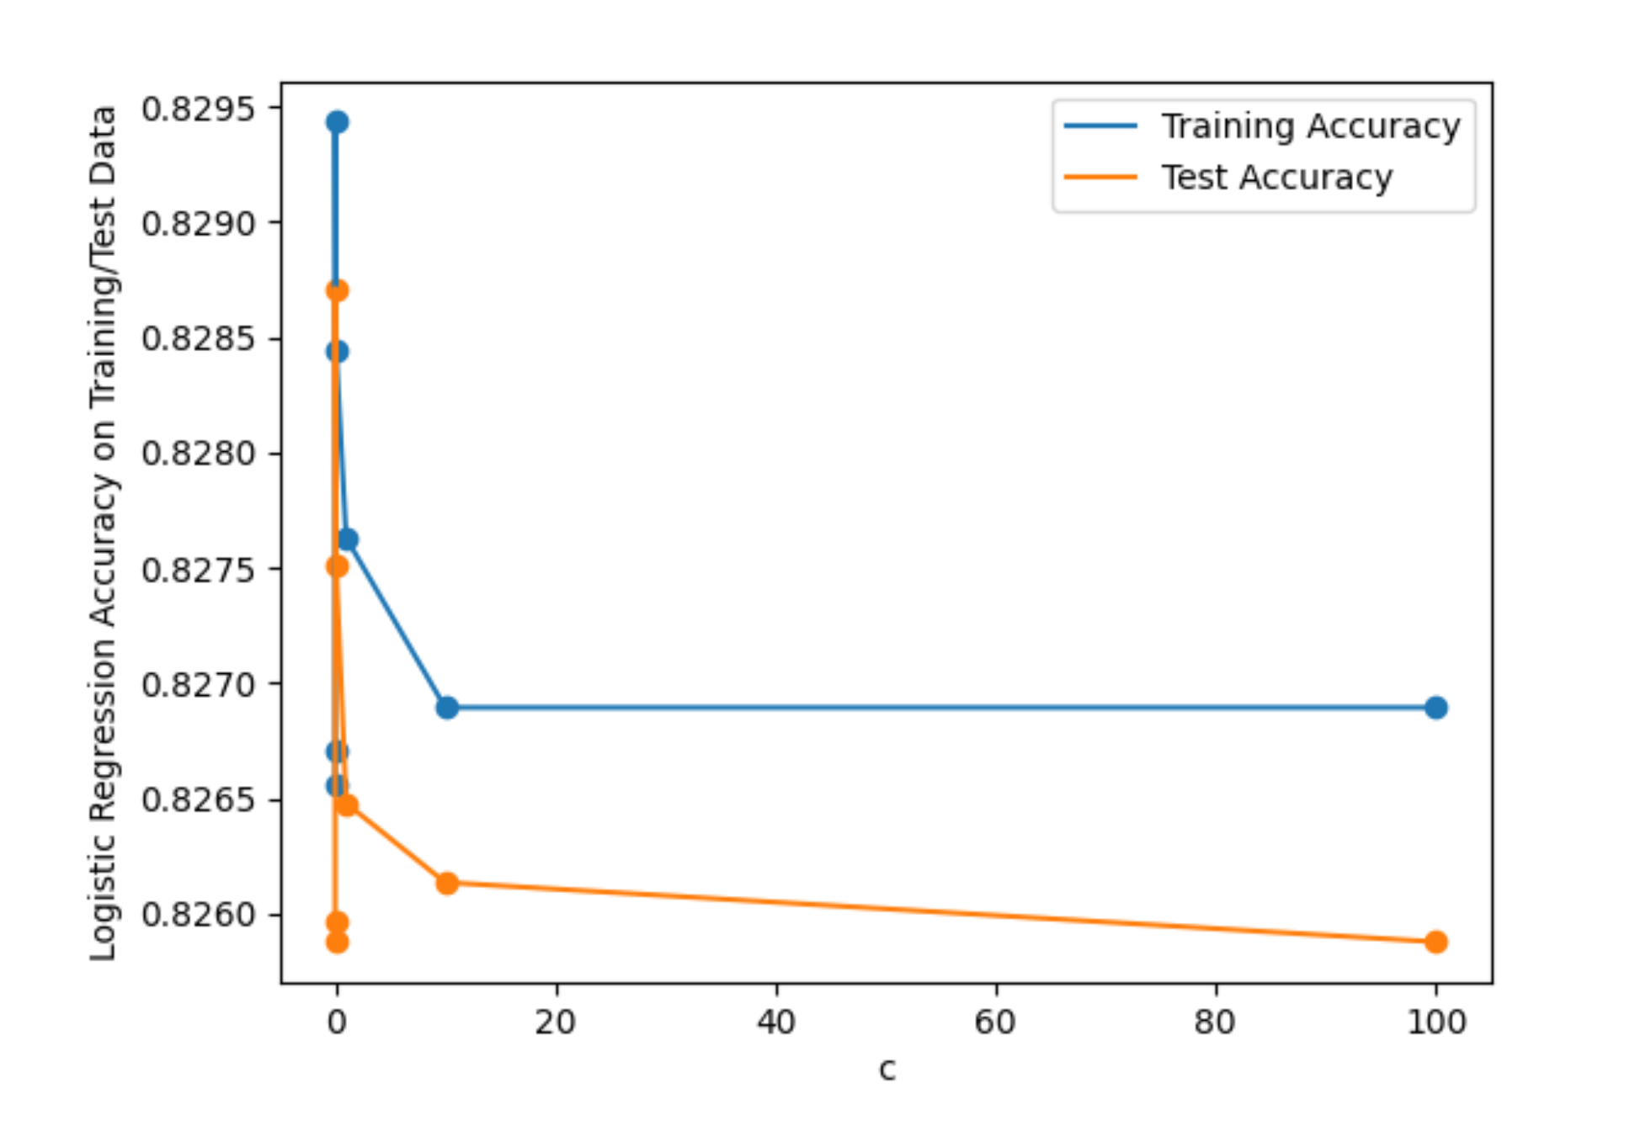
Supervised Analysis
Logistic regression with L2 regularization

Slide 11
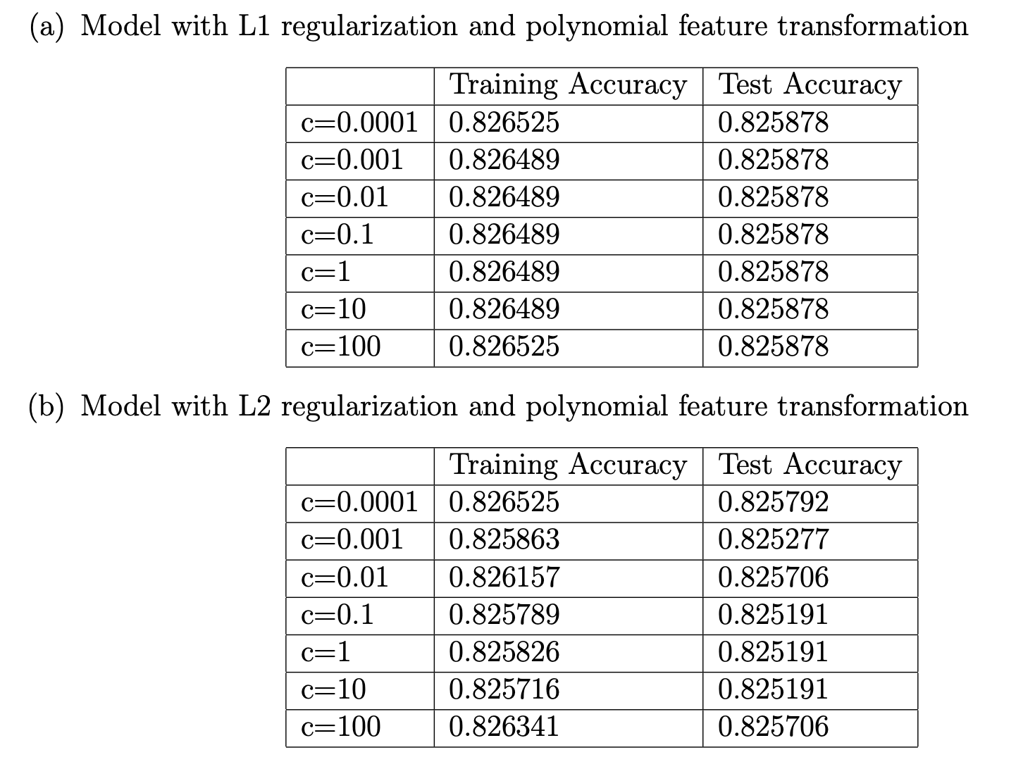
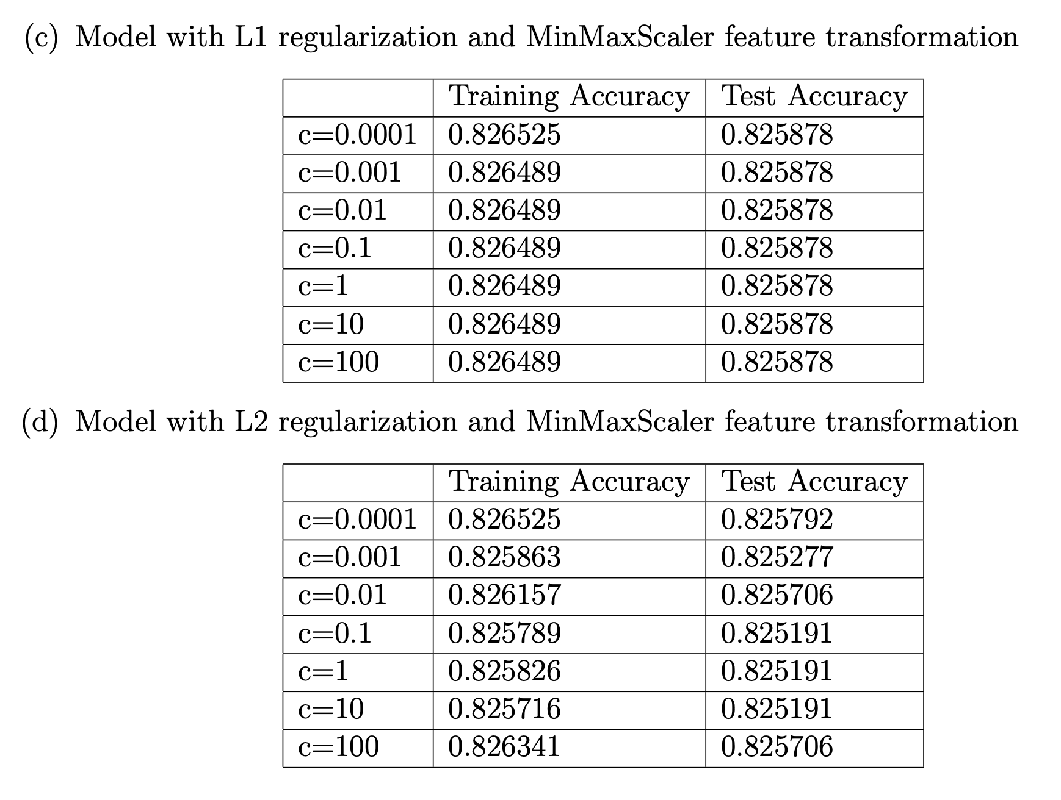
Tables of Results
Logistic regression

Slide 12
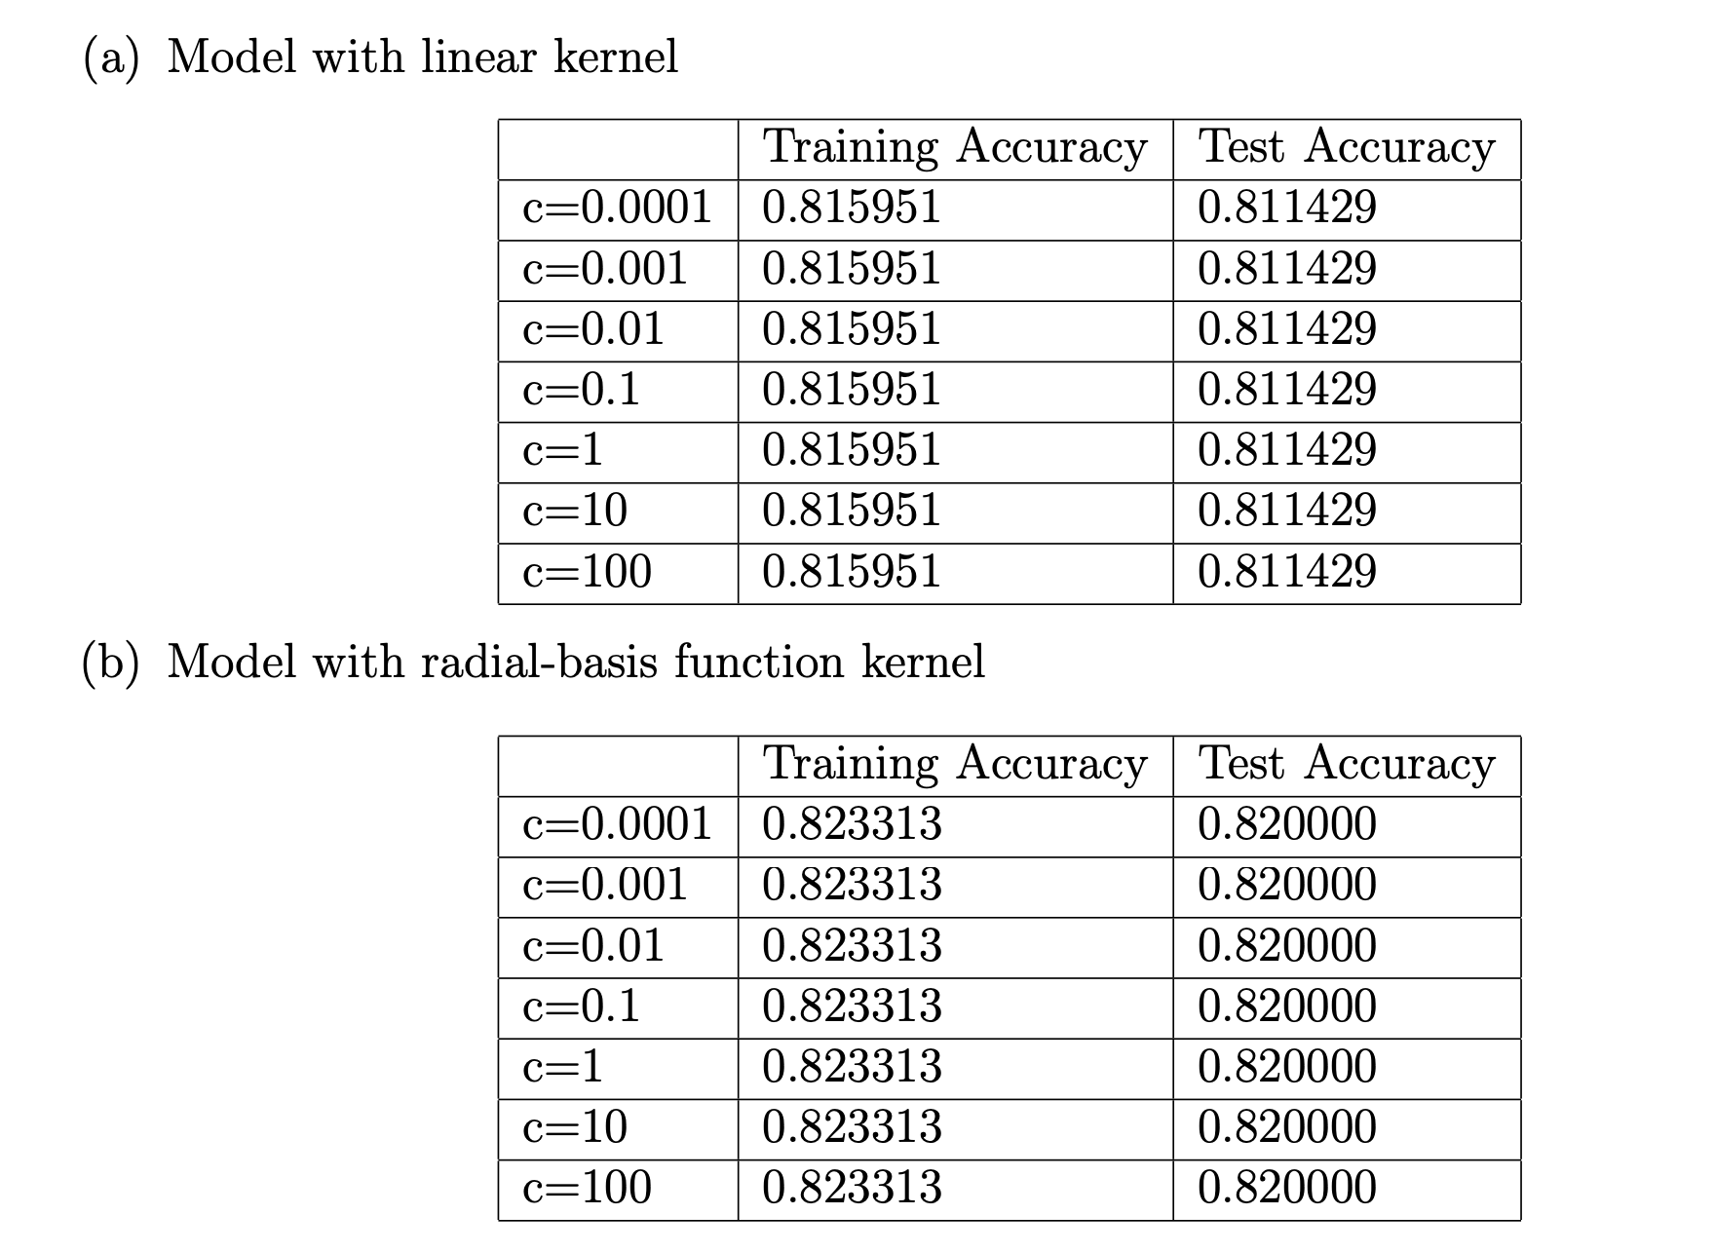
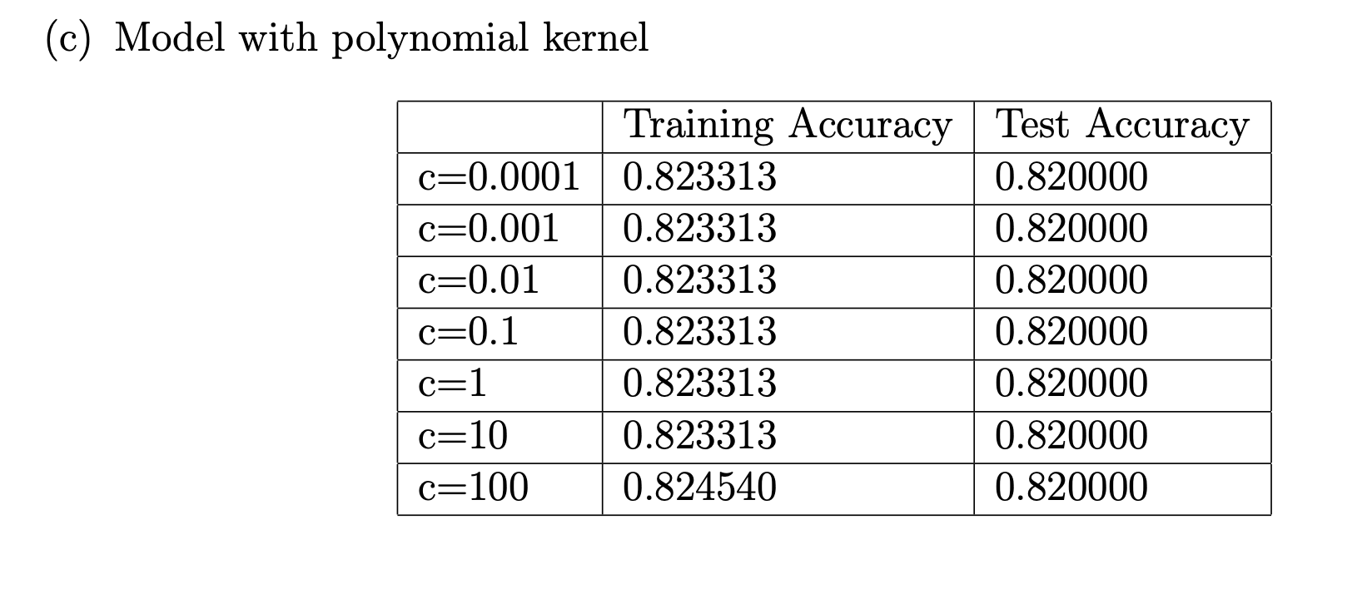
Tables of Results
Support Vector Machines

Slide 13
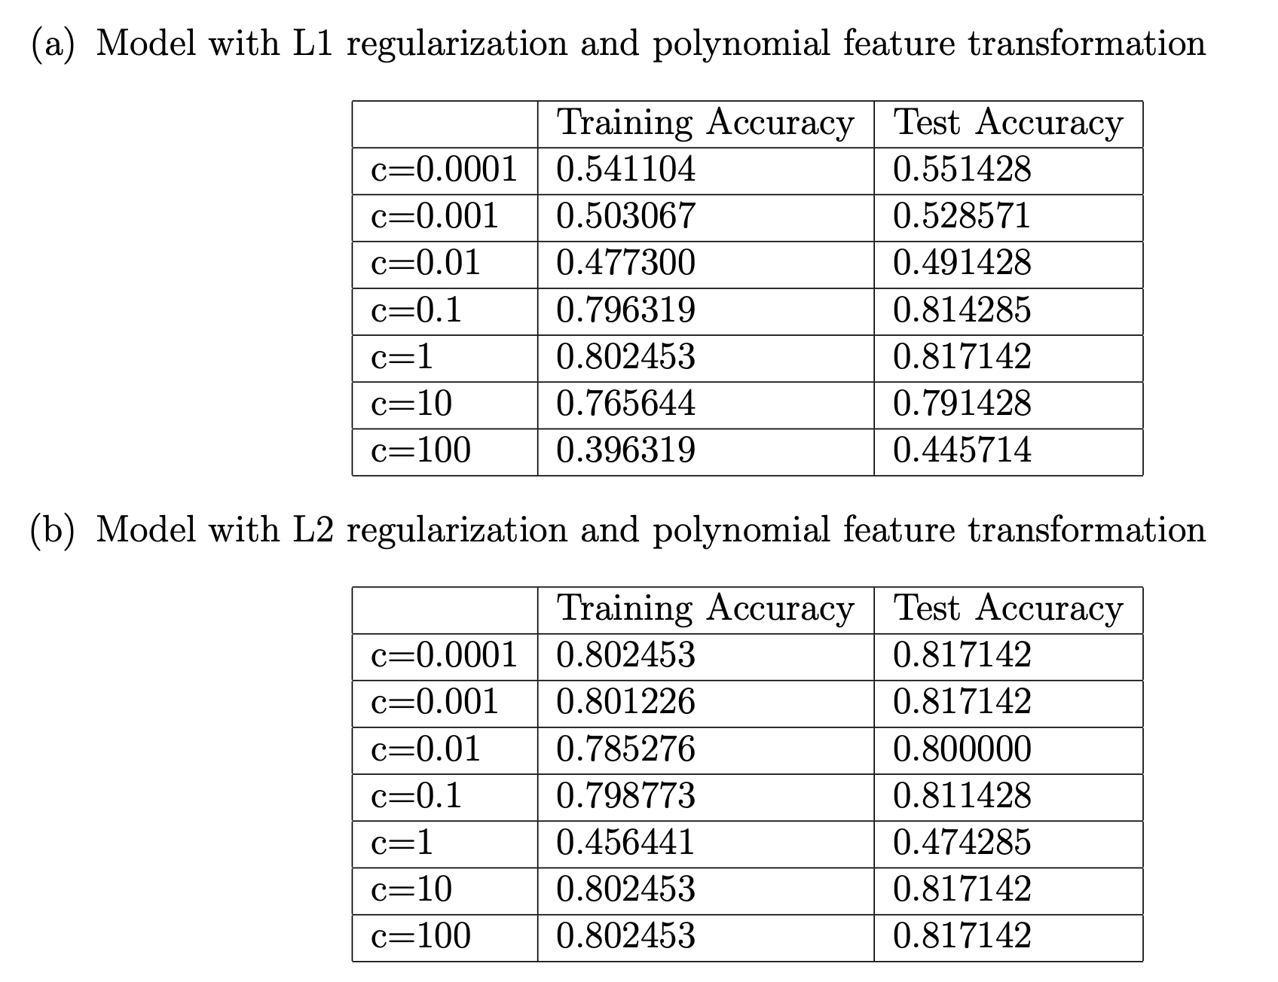
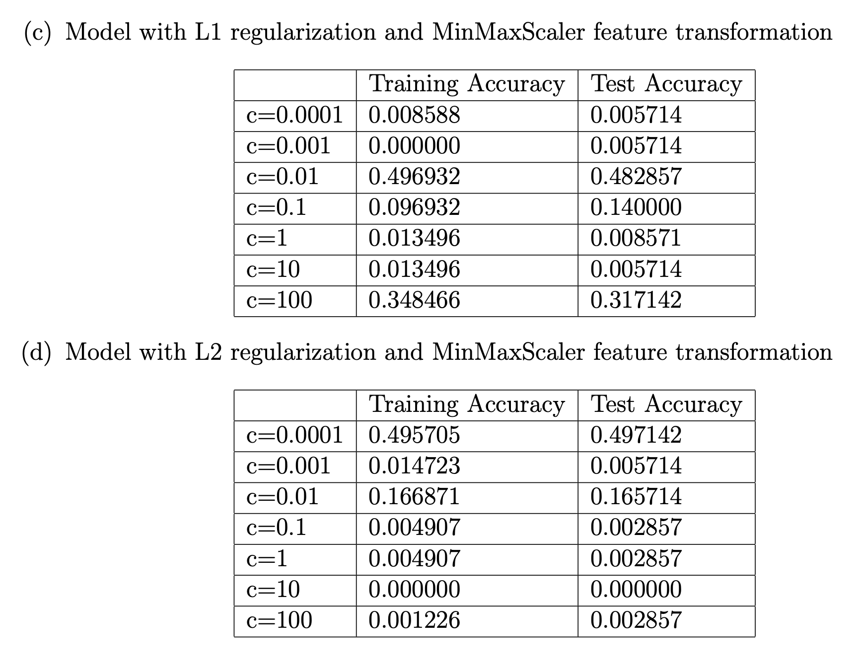
Tables of Results
Neural Networks

Slide 14
Conclusion
Highest test accuracy: Logistic regression with L1 regularization and polynomial feature transformation
Lowest test accuracy on average: neural networks with MinMaxScaler feature transformation
Neural networks with polynomial feature transformations yielded decent test accuracy
MinMaxScaler feature transformation yielded decent accuracy on logistic regression models
Same type of feature transformation can deliver vastly different performance on different types of models

Slide 15
Thank you for listening

